Slide 1



AWS STUDENT BUILDER GROUP
EGERTON UNIVERSITY
PRESENTS
NETWORKING:
AWS VPC
week
3
CLOUD
FORGE
Ephy Kimotho
25th June 2026
#AwsStudentbuilders

Slide 2







intro
Table of contents
INTRODUCTION TO VPCs
Security using NACLs and Security Groups
CIDR Notation
DEMO
Public & Private Subnets
Gateways (Internet & NAT)
#AwsStudentbuilders

Slide 3
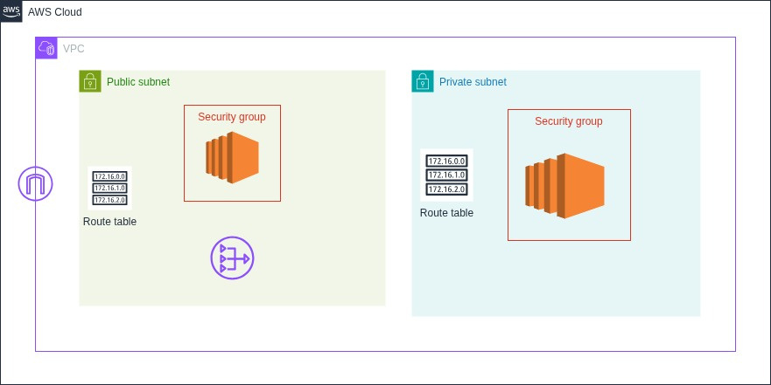
DEMO ARCHITECTURE DIAGRAM
#AwsStudentbuilders

Slide 4

What is a virtual private cloud (vpc) ?
When designing networks on AWS you need to understand the AWS Physical infrastrucutre, which is made up of Regions and Availability zones.
A Virtual network is a software defined network built on-top of a physical network. It emulates a physical network using software defined network components.
Amazon VPC is a programmatically defined and logically isolated virtual network . A VPC belongs to only one aws region.
To size your VPC, you allocate a range of private IP addresses. A range of these IP addresses is known as a CIDR Block, Classless Inter-Domain Routing. It’s very important to allocate an adequate number of IPs for your VPC because it’s time consuming and difficult to add more later.
The maximum IPv4 CIDR Block is a /16 netmask and the minimum is a /28 netmask. An example of a VPC CIDR Block is 10.0.0.0/16.
#AwsStudentbuilders

Slide 5
Subnets (Private & Public)
A subnet is a logically isolated subnetwork within the VPC. Subnetting allows for the breaking of a large network into smaller manageable sub networks.
Each subnet must always be associated to a route table that has routing rules that define where traffic within the subnet is directed to as well as egress traffic. After you create a VPC, it automatically comes with a local router which uses the main VPC route table. If a VPC is not explicitly associated to a route table, then it uses the main route table by default.
There are two types of subnets, Public subnets which can be accessed from the internet via an internet gateway and
private subnets which can not be accessed from the internet.
#AwsStudentbuilders

Slide 6
GATEWAYS (InterNet & NAT)
A gateway is a component that allows or denies traffic from moving from one point to another.
An internet gateway allows traffic from the internet into and out of a VPC. It’s a regional resource and must be attached to only one VPC.
An internet gateway is horizontally scalable allowing it to grow togehter with increase in traffic. As discussed earlier a subnet whose route table has a routing rule point to an internet gateway is known as a public subnet.
When you don’t want to expose a server’s IP address to other networks or the internet, it’s recommended to use a NAT gateway. It replaces the private IP of the request initiator with it’s own public facing IP acting as a proxy. They allow EC2 instances deployes in private subnets to access the internet, but not the vice versa.
A NAT gateway is always deployed in a public subnet.
#AwsStudentbuilders

Slide 7
ELASTIC IP
An Elastic IP address is a static IPv4 address that you can associate to an EC2 instance or a NAT Gateway.
If an EC2 instance’s health deteriorates, you can transfer the EIP address of the unhealthy EC2 instance to a healthy one.
EIPs are also attached to NAT gateways so that internet devices can send traffic back to the NAT gateway instead of private instances within private subnets. the EIP acts as a proxy IP address.
EIP addresses can also be attaches to Load Balancers and Network Interfaces.

Slide 8
Security using nacls & security Groups
You can secure your resources and VPCs using Security groups and Network Access Control Lists.
Security groups are statefull firewalls that act at the instance level and can span multiple AZs.
For each security group you add an inbound rule and outbound rule. Each rule has a port, protocol that allow you to specify the type of traffic to allow.
Network Access Control Groups NACL are an optional layer of security that operate at the subnet layer. They act as a firewall for controlling traffic in and out of your subnet. NACLS are not statefull and you need to define both ALLOW and DENY rules. You specify the port and protocol for the type of traffic as well.
Each subnet must associated with a NACL, if not the default NACL is used.
#AwsStudentbuilders

Slide 9
DEMO
#AwsStudentbuilders

Slide 10
AWS STUDENT BUILDER GROUP
EGERTON UNIVERSITY
Any
questions??
week
3
CLOUD
FORGE
Ephy Kimotho
25th June 2026
#AwsStudentbuilders

